Slide 1
Capstone Project - Car accident severity (Week 2)

Slide 2
Introduction:
When there is an accident happening on the road, a terrible traffic jam may be caused, which influences other people’s plans. It would be great if there is something in place that could warn people, given the weather and the road conditions about the possibility of people getting into a car accident and how severe it would be. So people would drive more carefully or even change their travels if they are able to. In this project, we will be working on a case study which is to predict the severity of an accident. We will try to use the accident data in Seattle City that include many influence factors of collisions for the prediction of the severity of an accident.
Notes:
Insert a map of your country.

Slide 3
Introduction:
Problems:
To improve the safely driving level of all the car users in Seattle City, we will try to find the answers to the following problems:
1) What are the main factors that influence the severity of an accident? How to list and visualize them?
2) How to use basic machine learning technologies to build a model to predict the severity of an accident?
Notes:
Insert a map of your country.

Slide 4
Data Section:
All collisions are provided by SPD and recorded by Traffic Records. This includes all types of collisions happening in Seattle City, which was updated weekly. Collisions will display at the intersection or mid-block of a segment.
Timeframe: 2004 to Present.
Contact Person: SDOT GIS Analyst
Contact Organization: SDOT Traffic Management Division, Traffic Records Group
Contact email: DOT_IT_GIS@seattle.gov
Notes:
Insert a picture illustrating a season in your country.

Slide 5
Data Section:
Data discussion:
We have the following discussion about the data:
1. The dataset includes 37 attributes. Some of them are much related to the severity of an accident, such as weather condition, car speeding and light conditions. Note that not all the attributes are useful.
2. There are many empty inputs in the accident data. For instance, the column “ROADCOND” includes 5012 empty inputs. There also exist both numerical and categorical types of data, which leads to the utilization of feature engineering.
3. The dataset has labels so that supervised machine learning technologies are suitable to predict the severity of an accident; nevertheless, the dataset is not label balanced. We should balance the data firstly before we create a model.
Notes:
Insert a picture illustrating a season in your country.

Slide 6
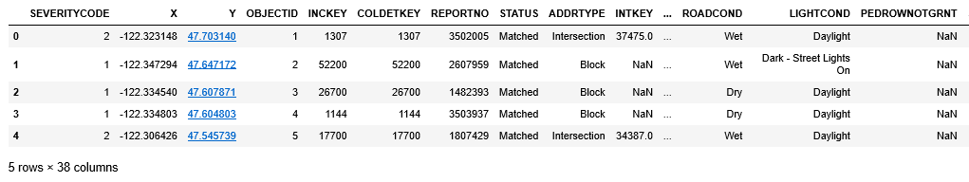
Methodology:
In this part, we mainly utilize logistic regression to classify the data for two groups according to different severity levels. The reason why we choose this method is that logistic regression has the advantage to classify data, especially for data belonging to two categories. Compared with SVM, logistic regression is much faster.
Firstly, let us do some Exploratory Data Analysis. The part of data can be shown as follows:
Notes:
Insert a picture of an animal and or plant found in your country.

Slide 7
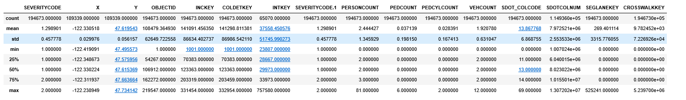
Methodology:
We can clearly see the dataset includes 38 columns (37 attributes). Note that some columns are categorical data, which leads to the need of feature engineering. We can also use the ‘describe’ method to show some features of the data, which can be seen hereafter:
Note that the above figure only includes the numerical data and some columns are useless for our prediction model.
Notes:
Insert a picture of an animal and or plant found in your country.

Slide 8
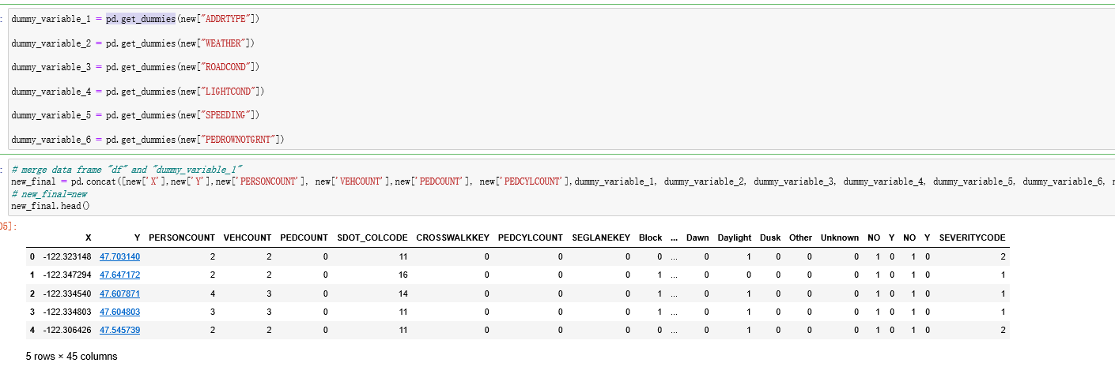
Methodology:
Regarding the feature engineering part, we selected 12 columns of data as model variables, which can be found hereafter: X, Y, ADDRTYPE, PERSONCOUNT, VEHCOUNT, PEDCOUNT, PEDCYLCOUNT, WEATHER, ROADCOND, LIGHTCOND, SPEEDING, PEDROWNOTGRNT. Note that the chosen of variables is based on life experience as well as the result of the correlation analysis.
As for the categorical data, we utilized the method “pd.get_dummies” to generate numerical variables. The detailed process can be found in the following code:
Notes:
Insert a picture of an animal and or plant found in your country.

Slide 9

Methodology:
As for ‘NaN’ values, we utilized the following code to remove them:
As for the categorical data, we utilized the method “pd.get_dummies” to generate numerical variables. The detailed process can be found in the following code:
Notes:
Insert a picture of an animal and or plant found in your country.

Slide 10
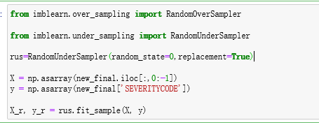

Methodology:
Another important issue is that the data is unbalanced. To fix this outstanding problem, we utilized the following code to create balanced dataset:
Then, the data normalization part can be seen as follows:
Notes:
Insert a picture of an animal and or plant found in your country.

Slide 11


Methodology:
The logistic model can be seen as follows:
Notes:
Insert a picture of an animal and or plant found in your country.

Slide 12
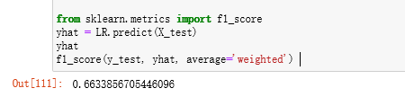
Results:
We utilized ‘f1_score’ to evaluate the accuracy of our model. The code can be seen as follows:
The final accuracy is 66.34%, which is actually not a very good result. However, according to our testing and our understanding of the dataset, we believe the accuracy is acceptable for this certain situation.
Notes:
Insert a picture of an animal and or plant found in your country.

Slide 13
Discussion
According to the results, we have the following recommendations:
1) The dataset is not very suitable for accurate prediction, because of many columns of categorical data and large amount of useless data. According to the results of correlation analysis, it is east to find there are not many columns relating to the severity of accidents. We believe more related data need to be collected for accurate prediction.
2) Normal machine learning techniques are not very suitable to this problem, even though the final results are acceptable. We have tried several methods to solve this problem such as SVM and decision tree; nevertheless, the results are basically same. We believe that neural networks can be utilized to deal with this problem and obtain higher accuracy level.
Notes:
Add key points in the history of your country to the timeline.

Slide 14
Conclusions
Through this capstone project, we have reviewed how to pre-processing data, how to do feature engineering and how to build a prediction model using basic machine learning techniques.
In this case, we utilized logistic regression method to build a model to predict the severity of an accident via 12 variables and the final result is acceptable.
Additionally, we also find the stage of data-processing is very important for the whole case study. Accurate data selection also directly determine the accuracy of our final model. In the future, we may try to utilize neural networks (even deep neural networks) to solve this problem. We believe the prediction accuracy will be better.
Notes:
Add key points in the history of your country to the timeline.

